Slide 1

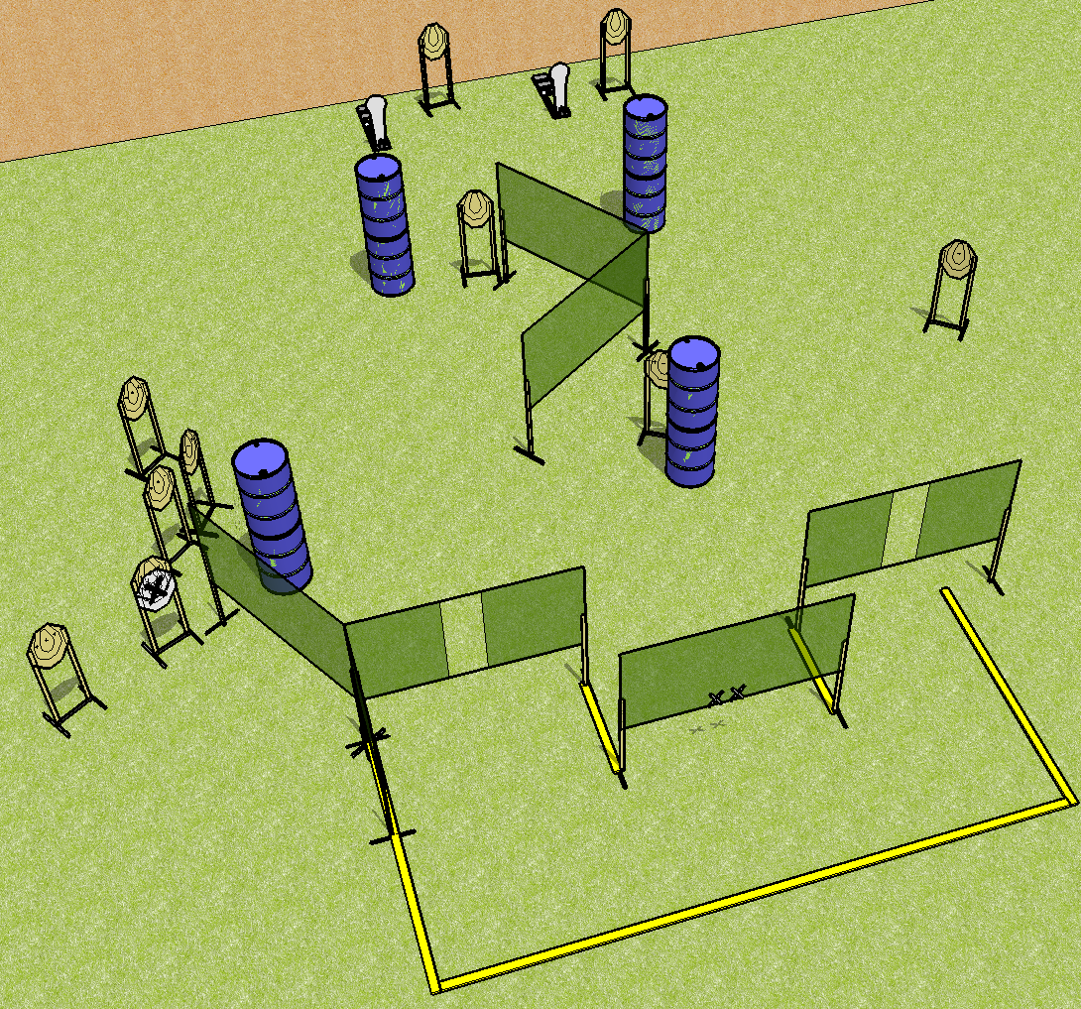
 | Dothan Practical Shooters – USPSA Match Stage 3 Course Designer : Drew Coleman Bay:
Round Count 22 rounds 10 IPSC 2 colt poppers
Equipment List 11 targets (10 + 1 NS)

Slide 2
Stage 3
Written Stage Briefing
Scoring: Comstock Rounds: 22
Targets: 10 IPSC, 2 steel
Handgun start position: anywhere inside the shooting area, wrists below belt. Handgun is loaded and holstered.
PCC start position: anywhere inside the shooting area, stock on belt. Loaded carbine is held with both hands, safety on.
Stage Procedure: On the audible start signal, engage targets as they become available from within the shooting area.

Slide 3
 | Dothan Practical Shooters – USPSA Match Stage 4 Course Designer : Drew Coleman Bay:
Round Count 32 rounds 10 IPSC 2 colt poppers
Equipment List

Slide 4
Stage 4
Written Stage Briefing
Scoring: Comstock Rounds: 32 rounds (best 3 on paper)
Targets: 10 IPSC, 2 steel
Handgun start position: hands touching marks. Handgun is UNLOADED and holstered.
PCC start position: muzzle touching either mark, stock on belt. Loaded carbine is held with both hands.
Stage Procedure: on the audible start signal, engage targets as they become available from within the shooting area.

Slide 5
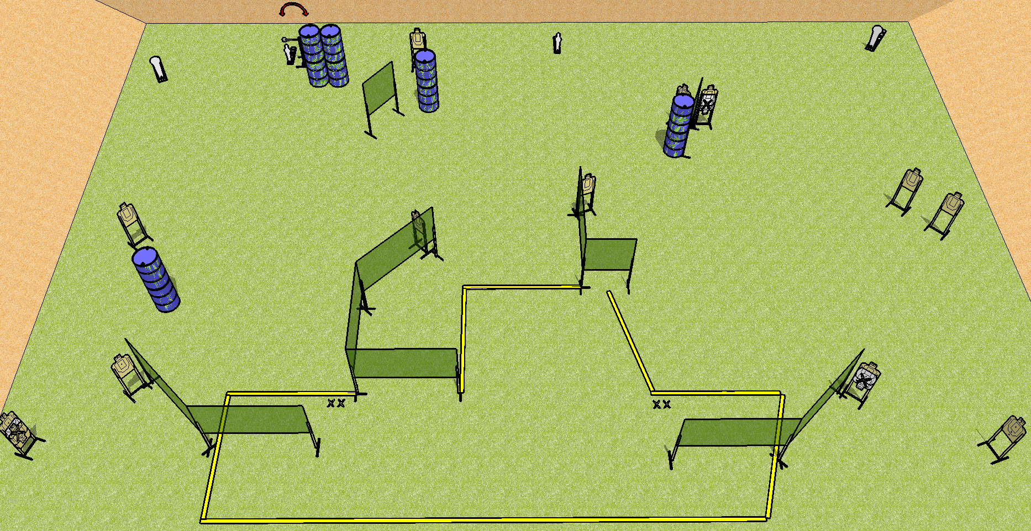
 | Dothan Practical Shooters – USPSA Match Stage 1 Course Designer : Drew Coleman Bay:
Round Count 32 rounds 14 USPSA 2 colts, 2 minis
Equipment List Swinger 17 targets (14 + 3NS)

Slide 6
Stage 1
Written Stage Briefing
Scoring: Comstock Rounds: 32
Targets: 14 USPSA, 4 steel
Handgun start position: straddling either start stick, wrists below belt. Handgun is loaded and holstered.
PCC start position: straddling either start stick, stock on belt. Loaded carbine is held with both hands, safety on.
Stage Procedure: on the audible start signal, engage targets as they become available from within the shooting area. The swinger is activated by P2 and remains visible at rest.

Slide 7
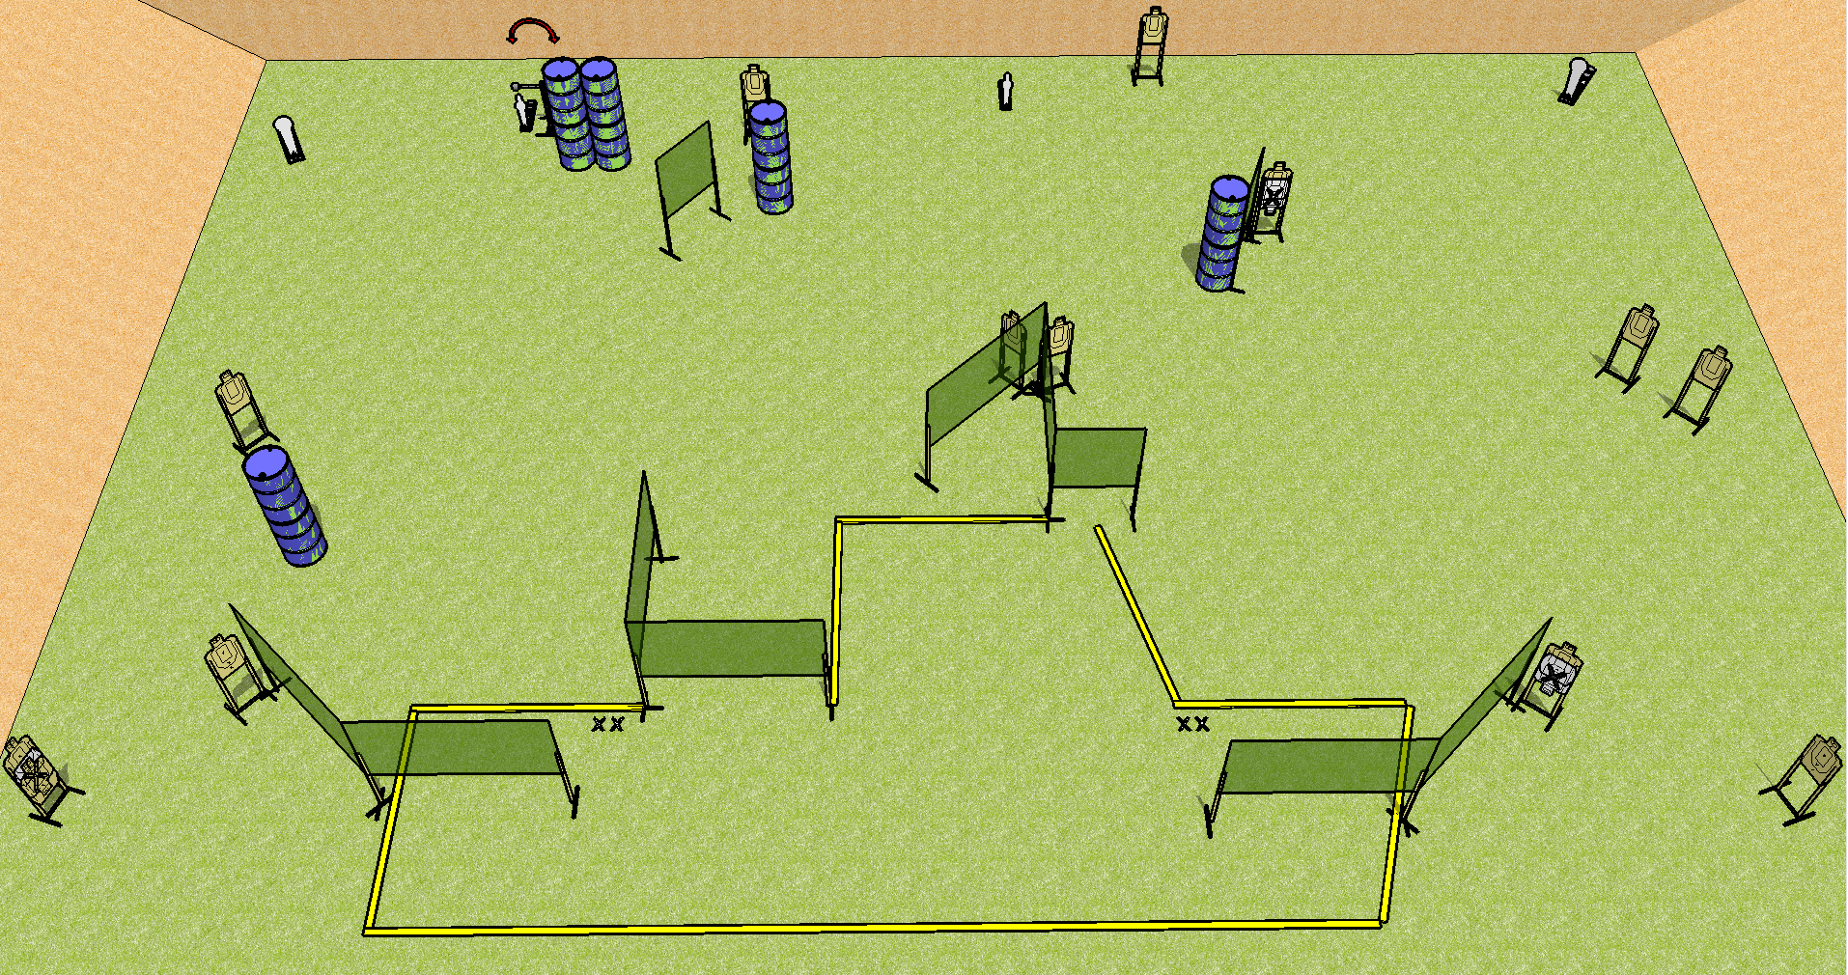
 | Dothan Practical Shooters – USPSA Match Stage 2 Course Designer : Drew Coleman Bay:
Round Count 32 rounds 14 USPSA 2 colts, 2 minis
Equipment List

Slide 8
Stage 2
Written Stage Briefing
Scoring: Comstock Rounds: 32
Targets: 14 USPSA, 4 steel
Handgun start position: anywhere inside the shooting area, wrists below belt. Handgun is loaded and holstered.
PCC start position: anywhere inside the shooting area, stock on belt. Loaded carbine is held with both hands, safety on.
Stage Procedure: on the audible start signal, engage targets as they become available from within the shooting area. The swinger is activated by P2 and remains visible at rest.

Slide 10


Move the circled wall and target to touch the long wall
Move the target behind the barrel in the upper right to the back
Spots will be marked with blocks spiked to the ground – orange to orange, white to white

